Slide 1
INTRODUCING
MIRO

Slide 2
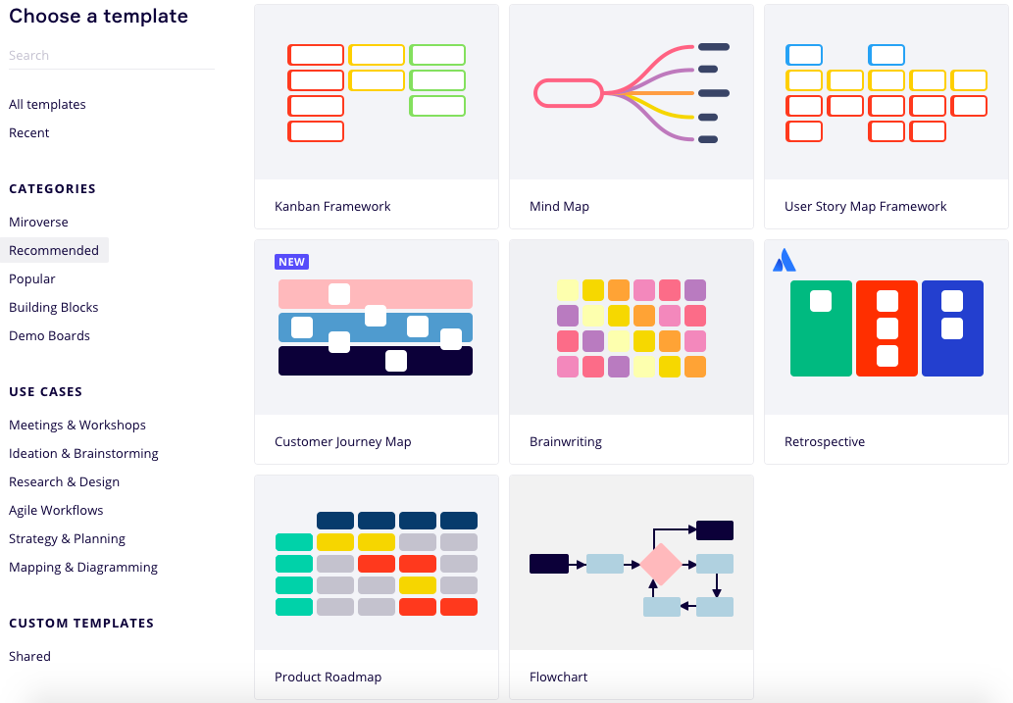

Slide 3
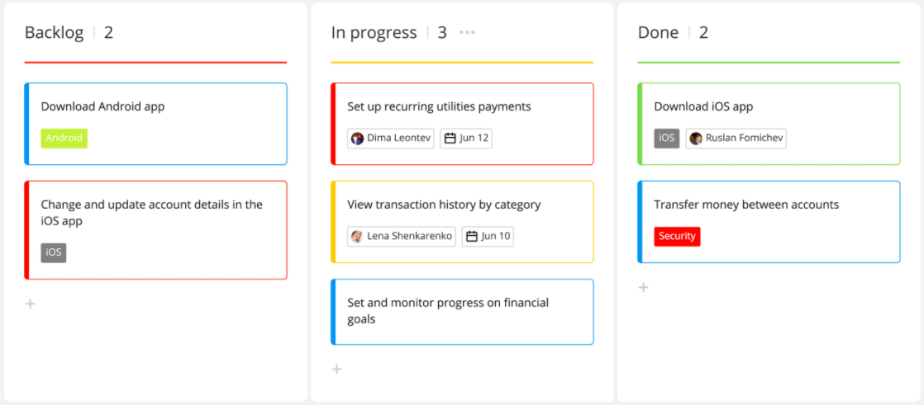
KANBAN FRAMEWORK

Slide 4
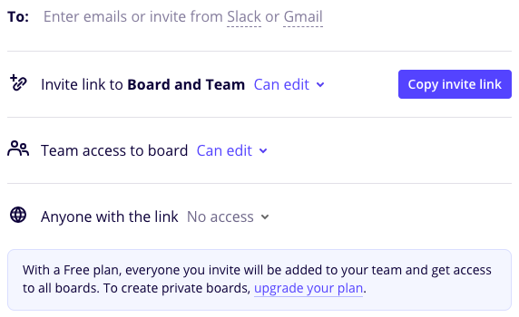
SHARE YOUR BOARD

Slide 5
INTRODUCING
TRELLO

Slide 6
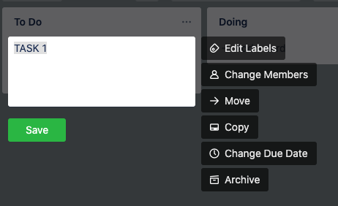
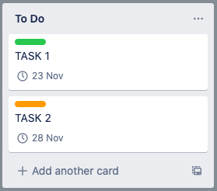
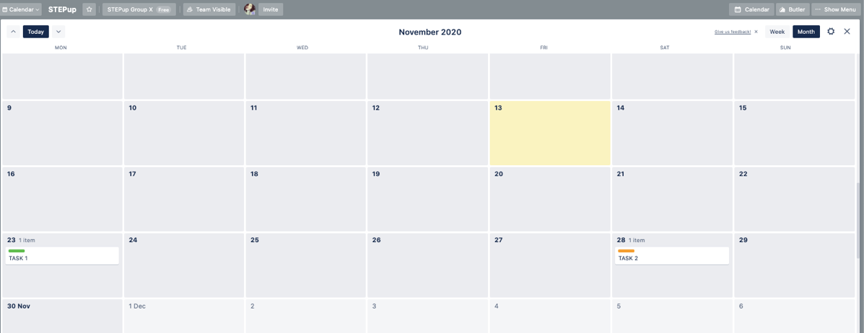

Slide 7
INTRODUCING
LEANSTACK

Slide 8
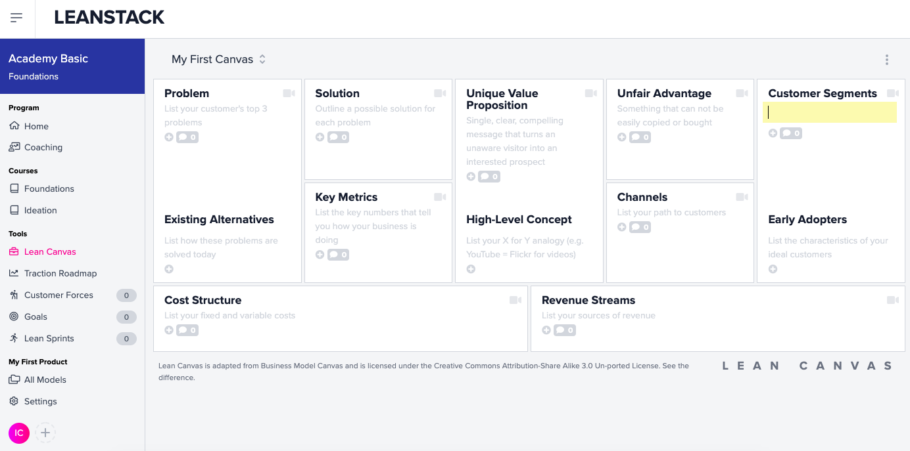
4
9
2
1
5
7
6
8
3

Slide 9
